Slide 1
Teaching Java using Turtles part 3
Barb Ericson
Georgia Institute of Technology
May 2006

Slide 2
Learning Goals
Explain how to change the pen width and color
Show that objects can refuse to do what you ask
Create a method to reuse a series of Java statements
  Compile it to turn it into something the computer understands
  Execute it to try it out
  Show how to make it more reusable

Slide 3
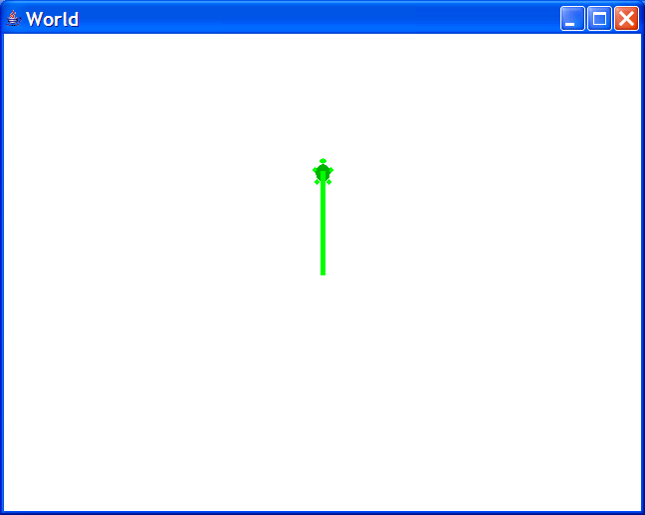
Setting the Pen Width
You can change the width of the trail the pen leaves
  World world1 = new World();
  Turtle turtle1 = new Turtle(world1);
  turtle1.setPenWidth(5);
  turtle1.forward(100);
Notes:
You will need to reset the interactions pane before you try this. Click on the “Reset” button at the top of the window.

Slide 4
Setting the Pen Color
Use setPenColor to set the color of the pen
  turtle1.setPenColor(java.awt.Color.RED);
There are several predefined colors
  In the package java.awt
    A package is a group of related classes
  In the class Color
To use them you can use the full name
  java.awt.Color.RED
Notes:
Other colors are java.awt.Color.BLACK, java.awt.Color.BLUE, java.awt.Color.GREEN, java.awt.Color.GRAY, java.awt.Color.YELLOW, java.awt.Color.ORANGE, java.awt.Color.CYAN, java.awt.Color.MAGENTA, java.awt.Color.WHITE

Slide 5
Setting Colors
You can change the pen color
  turtle.setPenColor(java.awt.Color.RED);
You can change the turtle color
  turtle1.setColor(java.awt.Color.BLUE);
You can change the turtle’s body color
  turtle1.setBodyColor(java.awt.Color.CYAN);
You can change the turtle’s shell color
  turtle1.setShellColor(java.awt.Color.RED);
Notes:
When you change the pen color all the lines drawn by that turtle will change to the new color.
When you change the turtle color you are really changing the body color. The shell color will be a darker shade, if there is no specified shell color.

Slide 6
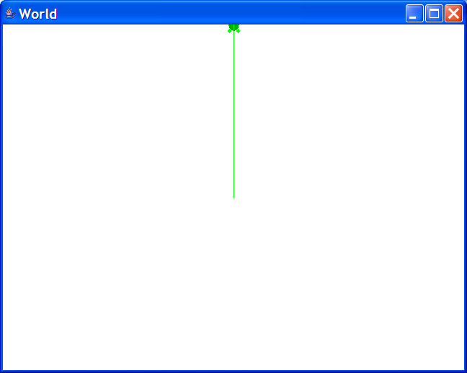
Objects can Refuse
Turtles won’t move completely out of the boundaries of the world
  World world2 = new World();
  Turtle turtle2 = new Turtle(world2);
  turtle2.forward(600);

Slide 7
Objects send Messages
Objects don’t “tell” each other what to do
  They “ask” each other to do things
Objects can refuse to do what they are asked
  The object must protect it’s data
    Not let it get into an incorrect state
    A bank account object shouldn’t let you withdraw more money that you have in the account

Slide 8
Creating a Method
We can name a block of Java statements and then execute them again
  By declaring a method in a class
The syntax for declaring a method is
  visibility returnType name(parameterList)
  Visibility determines access
    Usually public or private
    The return type is the type of thing returned
    If nothing is returned use the keyword void
  Name the method starting with a lowercase word and uppercasing the first letter of each additional word

Slide 9
Example Method
public void drawSquare()
{
this.turnRight();
this.forward(30);
this.turnRight();
this.forward(30);
this.turnRight();
this.forward(30);
this.turnRight();
this.forward(30);
}
The visibility is public
The keyword void means this method doesn’t return a value
The method name is drawSquare
There are no parameters
  Notice that the parentheses are still required
The keyword this means the object this method was invoked on

Slide 10
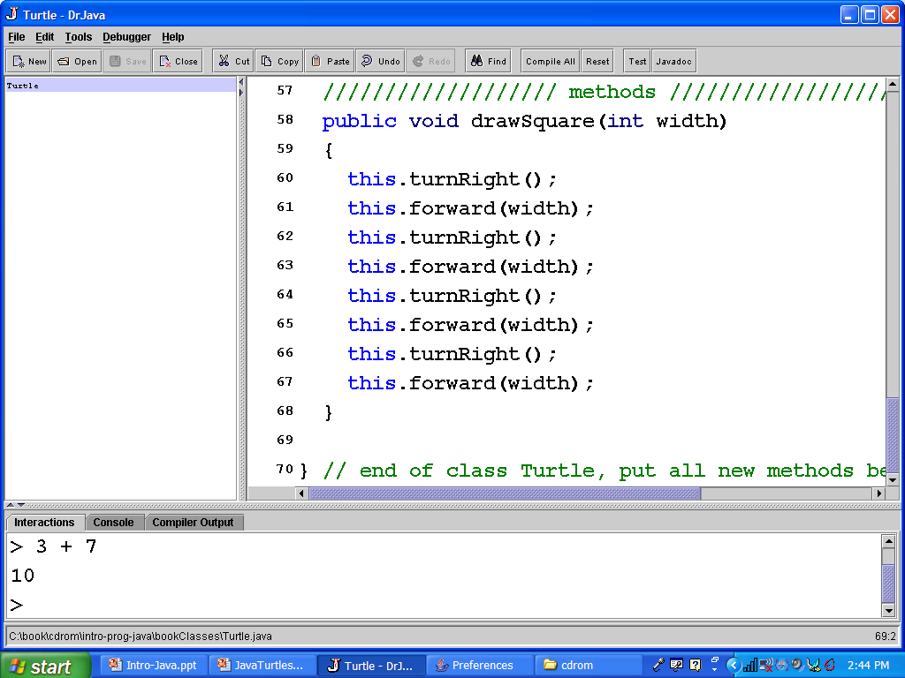
Adding a Method to a Class
1. Open file Turtle.java
3. Compile open files
2. Type the method before the last } // end
Notes:
To add a method to a class open the file that defines the class. Then add the method before the last curly brace in the file. Then compile the file by clicking on the Compile All button. Then you are ready to try out your method in the interactions pane.

Slide 11
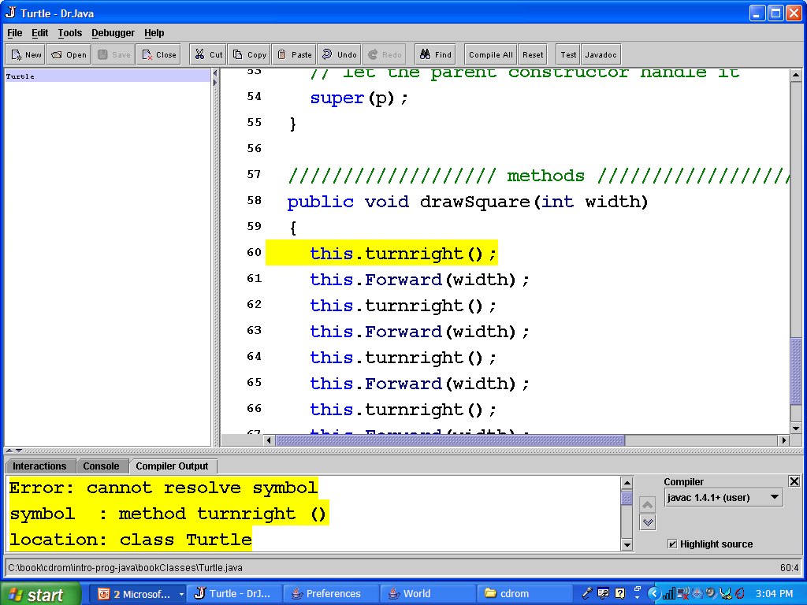
Compile Errors
Case matters in Java! turnright isn’t the same as turnRight
Clicking on the error takes you to the code and highlights it.
Notes:
You can click on each error. The definitions pane will go to that error and highlight the code that is in error.
Common errors are wrong case, wrong name, wrong parameters, missing ending semicolon, and that the method is inside the class (before the last } in the file).
After you fix any errors you will need to compile again. Keep compiling and fixing errors until there are no more errors.

Slide 12
Try the New Method
Compiling resets the interactions pane
  Clearing all variables
    But you can still use the up arrow to pull up previous statements
  You will need to create a world and turtle again
    World world1 = new World();
    Turtle turtle1 = new Turtle(world1);
    turtle1.forward(50);
    turtle1.drawSquare();
    turtle1.turn(30);
    turtle1.drawSquare();

Slide 13
Saving the Interactions History in DrJava
You can save the interactions history into a script
  And optionally edit it first before you save it
  Click on Tools then on Save Interactions History
And then latter load and execute the statements in the script
  Click on Tools and Load Interactions History as Script
    Use the next button to see the next statement and click on the execute button to execute it

Slide 14
Better Method to Draw a Square
A method to draw a square
public void drawSquare()
{
int width = 30;
this.turnRight();
this.forward(width);
this.turnRight();
this.forward(width);
this.turnRight();
this.forward(width);
this.turnRight();
this.forward(width);
}
We added a local variable for the width
  Only known inside the method
This makes it easier to change the width of the square
But, we still have to recompile to draw a different size square

Slide 15
Testing the Better Method
Type the following in the interactions pane
  World world1 = new World();
  Turtle turtle1 = new Turtle(world1);
  turtle1.forward(50);
  turtle1.drawSquare();
  turtle1.turn(30);
  turtle1.drawSquare();
Or use the saved script if you saved the last interactions history

Slide 16
Passing a Parameter
public void drawSquare(int width)
{
this.turnRight();
this.forward(width);
this.turnRight();
this.forward(width);
this.turnRight();
this.forward(width);
this.turnRight();
this.forward(width);
}
Parameter lists specify the type of thing passed and a name to use to refer to the value in the method
The type of this parameter is int
The name is width
Values are passed by making a copy of the passed value
Notes:
Adding parameters to methods makes them more reusable.

Slide 17
Testing with a Parameter
Type the following in the interactions pane
  World world1 = new World();
  Turtle turtle1 = new Turtle(world1);
  turtle1.forward(50);
  turtle1.drawSquare(30);
  turtle1.turn(30);
  turtle1.drawSquare(50);

Slide 18
How Does That Work?
When you ask turtle1 to drawSquare(30)
  turtle1.drawSquare(30);
  It will ask the Turtle Class if it has a method drawSquare that takes an int value
    And start executing that method
    The parameter width will have the value of 30 during the executing of the method
    The this keyword refers to turtle1
When you ask turtle1 to drawSquare(50)
  turtle1.drawSquare(50);
  The width will have a value of 50
  The this refers to turtle1 (the object the method was invoked on)

Slide 19
Challenges
Create a method for drawing a rectangle
  Pass the width and height
Create a method for drawing an equilateral triangle
  all sides have the same length
  Pass in the length
Create a method for drawing a diamond
Create a method for drawing a house
  Using the other methods
Create a method for drawing a school
  Using the other methods

Slide 20
Summary
To create a method
  visibility returnType name(Type name, Type name, …)
  Let’s you reuse a block of statements
Examples
  public drawSquare()
  public drawSquare(int width)
You can make methods more useful by allowing them to take parameters

